Slide 1
Tsugi Marketing Tour

Slide 2

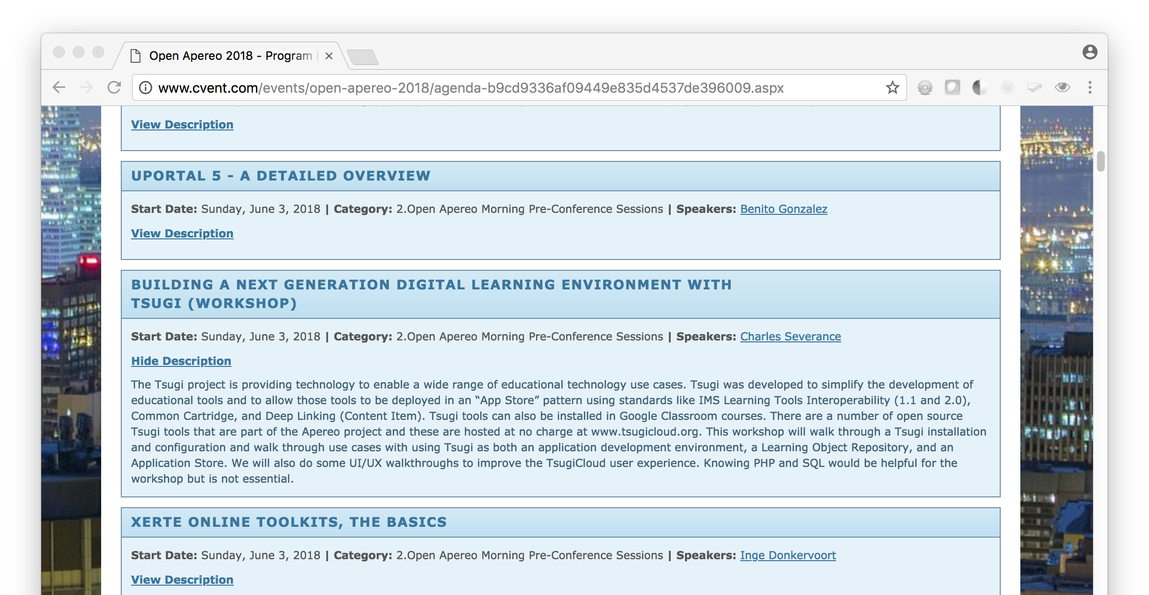

Slide 3


Slide 4
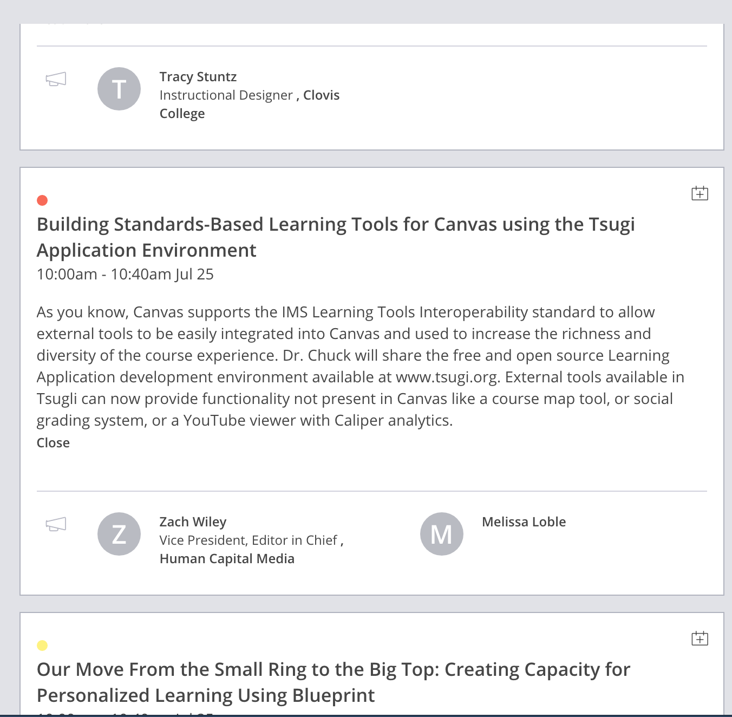
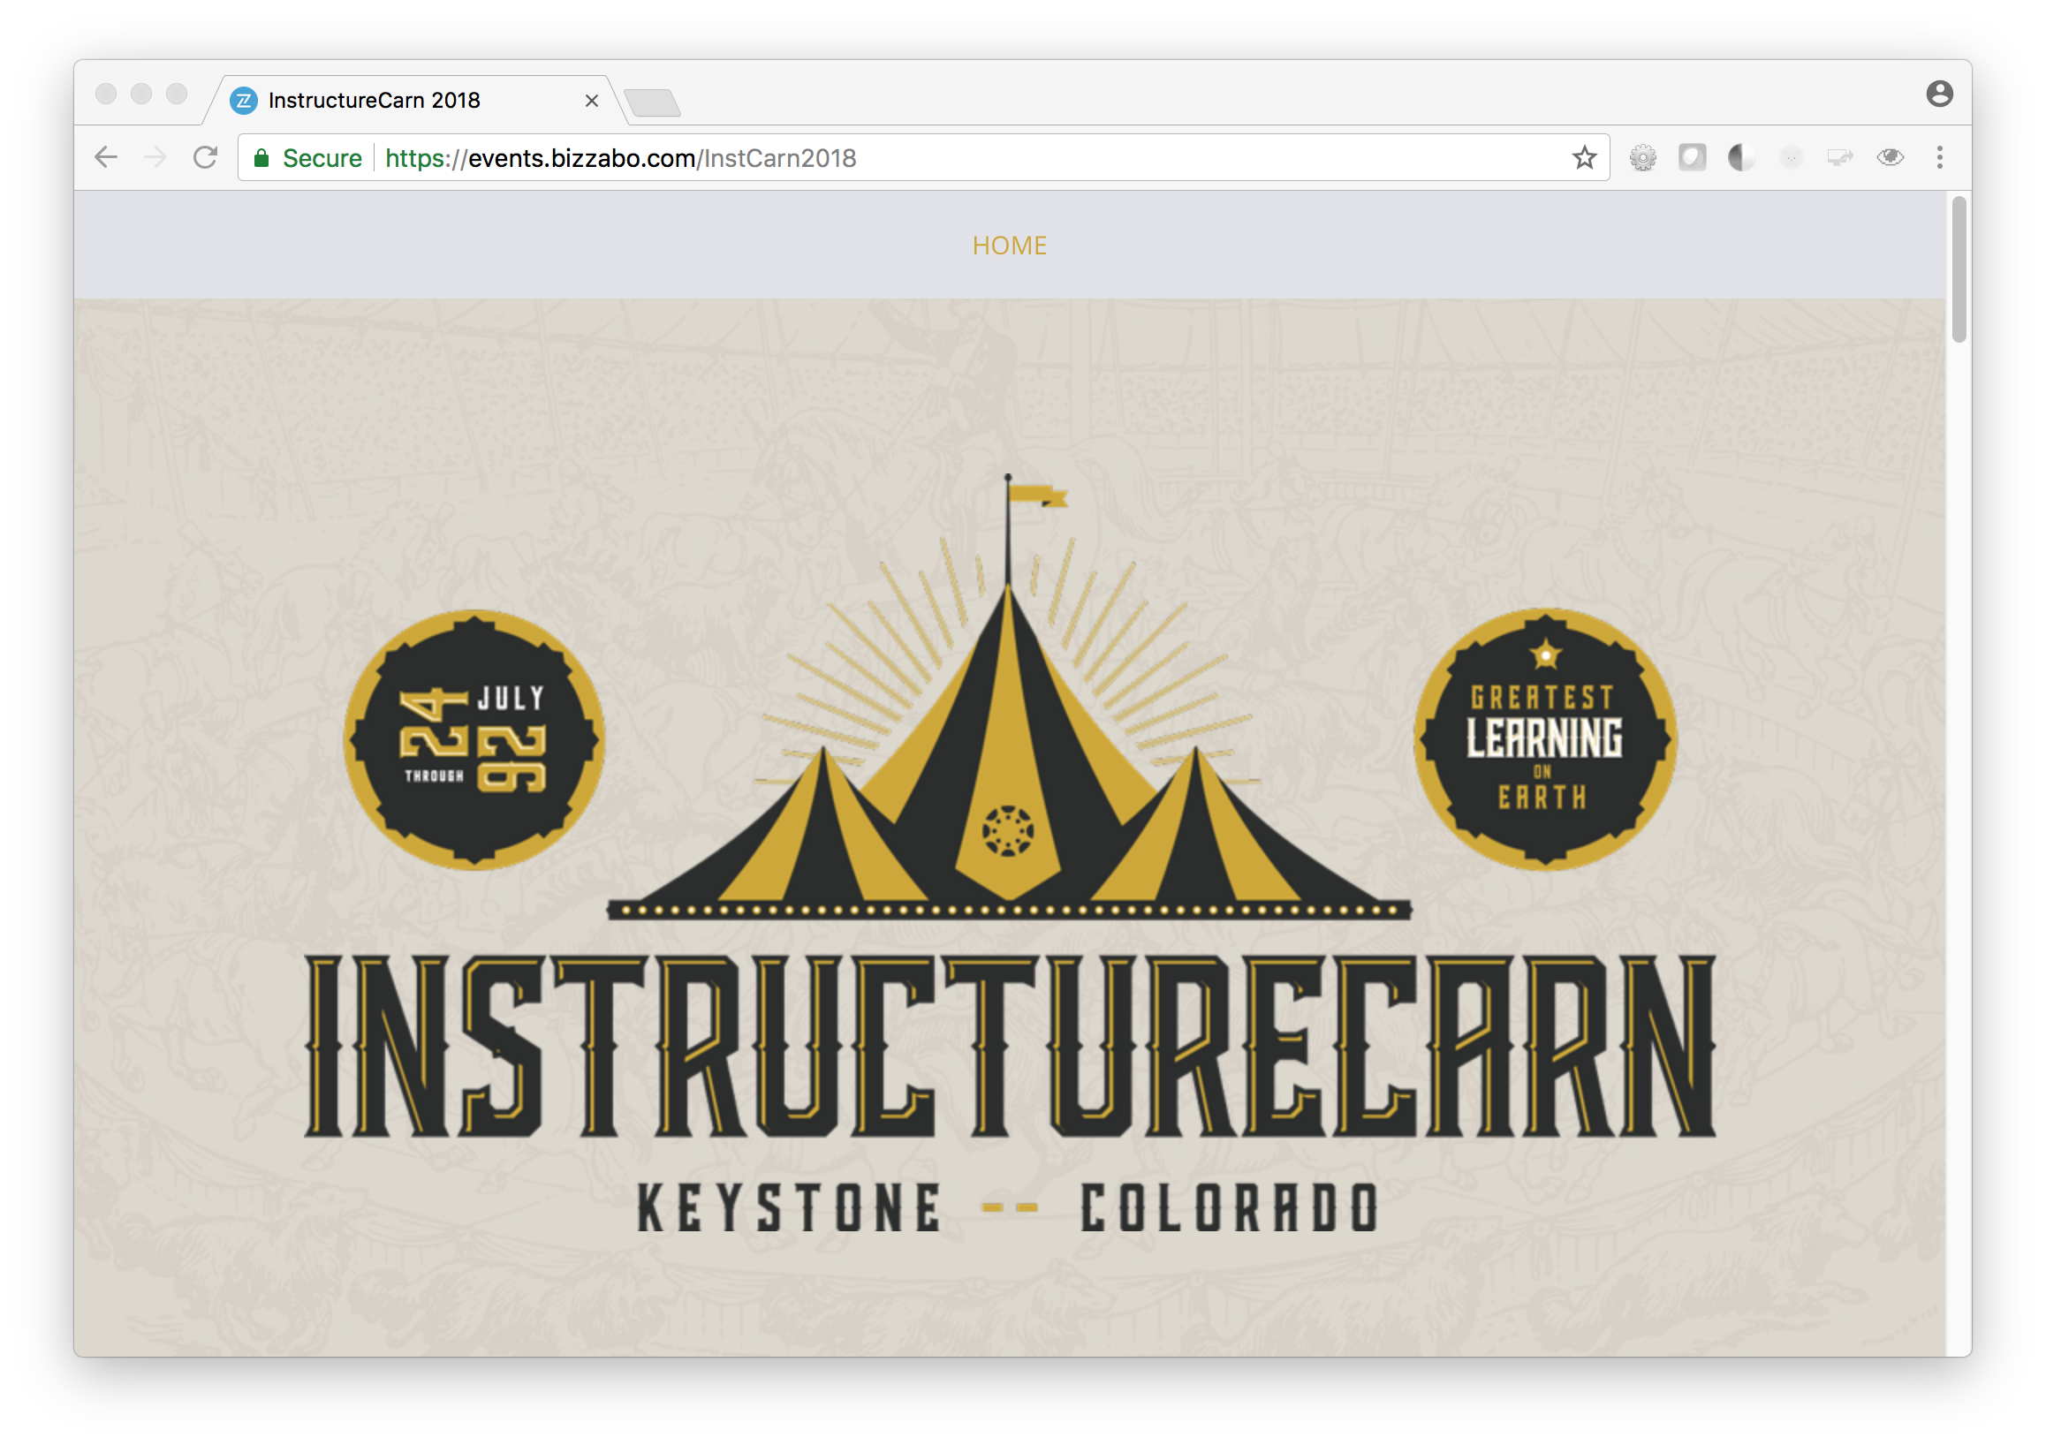

Slide 5
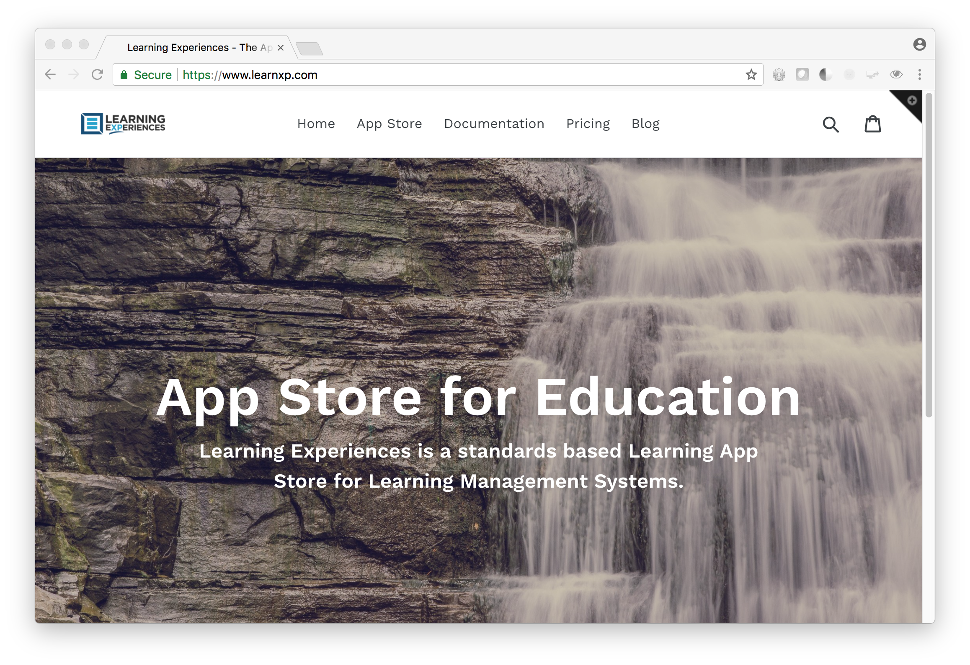
Tsugi Commercial Affiliate
Learning Experences
OpenApereo2018 Sponsor
www.learnxp.com
Radically open approach
Cloud recipes open
Schools can use
Other commercial affiliates can use
International / GDPR
Desire – completely independent commercial affiliates in major legal domains
Spain / South Africa / Germany

Slide 6
